Slide 1
THE NEW ADMINISTRATION AND Know your rights chris stanislowski
Tacoma office
402 Tacoma Avenue south, suite 100
Tacoma, Washington 98402
Northwest Immigrant Rights Project/
Proyecto para los Derechos del Inmigrante

Slide 2
This information is not intended to provide legal advice to any individual or entity; You should consult with an experienced immigration attorney if you have any questions. This document was last updated September 13, 2017. Please note that some of the laws or policies discussed may change in the future.

Slide 3

Northwest Immigrant Rights Project
  The only organization that provides comprehensive legal immigration services for low-income people in Washington State.
  Principal Focus: Direct legal representation
  Also: Creating systemic change in the practices and public policies that affect immigrants through high-impact litigation, public policy, and community education.
  Four offices: Seattle, Granger, Wenatchee, and Tacoma (only for detained persons)

Slide 4
Today’s event…
Part 1 – Executive Orders and New Administration Changes
Part 2 – Protections for Vulnerable People
Part 3 – What You Can Do
  Safety Planning
  Know Your Rights
Part 4 – How to Get Help and Questions

Slide 5
Important Messages
There are reasons to worry, but not to panic;
We don’t know exactly what’s going to happen;
All people who are in the United States have constitutional rights under the law, which the new President can’t eliminate;
It’s very important that we be alert;
It’s very important that we be prepared;
It’s very important that we be organized.

Slide 6
What we know right now
Executive Orders
More enforcement of immigration laws
Many things that the community must do to prepare, saving $$ for bonds
We should be conscious of hate crimes/“bullying”

Slide 7
Interior Enforcement Executive Order (January 25, 2017)
New Enforcement Policies
  Anyone who has been charged with a criminal offense, or
  Has committed acts that constitute a chargeable criminal offense, or
  Is “in the opinion of an immigration official” a risk to the public.
  Fines for those who “facilitate” the presence of undocumented persons in the U.S.
  10,000 more immigration officers, but no additional immigration judges
  Increased state enforcement of immigration law
  Withholding of federal funds from “sanctuary cities”
Notes:
Qu

Slide 8
Border Security Executive Order (January 25, 2017)
Endangered asylees
Construction of the wall on the southern border
More detention centers on the southern border
Increase in the number of detainees at the southern border
5,000 more border-patrol officers – no additional immigration judges
A process for deportation in Mexico
More state-federal enforcement partnerships
Possibility of removal without a hearing for persons who have been in the US for more than 2 years

Slide 9
Travel Ban 1 - Executive Order National Security (January 27, 2017)
Signed by the President
Suspends for 90 days the entrance of people from 7 countries (Iraq, Iran, Syria, Yemen, Somalia, Sudan, Libya)
  Prohibits the entrance of any refugee for 120 days
  Prohibits indefinitely the entrance of refugees from Syria
  Implementation was immediate and chaotic- affecting refugees, persons with visas, and permanent residents
Court Actions (stay and TRO=temporary restraining order)
  NWIRP and State of Washington
  A panel of 3 judges affirmed the stay and TRO

Slide 10
Travel Ban 2 - Executive Order National Security (3/6/17)
Bans admission for 90 days for nationals of six countries: Iran, Libya, Somalia, Sudan, Syria, and Yemen (Iraq removed from list), with exceptions for those already admitted to the U.S. with lawful status
Suspends refugee admission for 120 days
Decreases refugee admission to 50,000
Exceptions: green card holders, valid visa, dual nationals, asylees/refugees
Heightened screening; Case-by-case waiver (unclear mechanism)
UPDATE: Appeal is pending with the Supreme Court. A federal district court enjoined the travel ban as it applied to refugees and other close family members. The Supreme Court stayed this injunction as it applied to refugees. In short, refugees from the six countries are currently unable to enter the U.S.

Slide 11
Expected changes in immigration enforcement
Increased focus on those who have contact with the criminal-justice system
More enforcement in the counties along the northern border
More “fugitive operations” in search of persons with final removal orders
Employment raids
Fewer cases of prosecutorial discretion
More detention in immigration centers
ICE fingerprint tablets
Notes:
As

Slide 12
What could happen, and when
Fastest changes and Executive Orders
  DACA, enforcement priorities, employment raids
Not as fast, and congressional action not required
  Rules, for example, provisional waiver
Takes more time and requires congressional action
  Money: more agents/detention/more immigration courts
  Changes to immigration law: U visas, VAWA protections, asylum, SIJS
Notes:
What can happen and when
Faster Changes and Executive Orders
DACA, Priorities of enforcement, raids on employment
Not so fast and congressman action not necessary
Rules, example perdon provisionale
Take more time and necessary congressional action
Money: more agents / detention / more immigration cuts
Changes to Immigration Law:
Mandatory e-check and more fines for immigration violations

Slide 13
Hate Crimes / Bullying
Increase in hate crimes, harassment, and bullying
If incident rises to level of crime, contact police (9-1-1- if emergency)
Bullying / harassment resources:
  We encourage reporting hate crimes to:
    Your local school (if the bullying/crime took place at or near the school)
    ACLU-WA (206) 624-2184, or
    CAIR-WA (206) 367-4081 (for crimes against Muslim community members)
  Report discrimination to: federal, state, local agencies
    FBI Seattle: (206) 622-0460
    State Attorney General: (360) 753-6200

Slide 14
DACA/DREAMers
NWIRP’s DACA practice advisory: https://www.nwirp.org/wp-content/uploads/2017/09/Daca-Community-Advisory.pdf
On 9/5/2017, the Trump administration announced it would be phasing our DACA program in six months (3/5/2017)
Any renewal applications must be received by 10/5/2017
Unlikely that administration will target former DACA recipients en masse, but those with criminal convictions or a prior deportation order are at higher risk
No new applications will be accepted at this point

Slide 15
DACA/DREAMers (continued)
Individuals will lose work permits when DACA status expires
Some state public benefits are not available to undocumented individuals, and once an individual loses DACA status, they will not be eligible to continue receiving those benefits
Still keep SSN and continue to be eligible for a WA driver’s license (though starting in July 2018, the license will be marked as not valid for federal purposes)
NWIRP and WDC are hosting DACA clinics to help individuals re-apply and to screen for other possible relief. Individuals can also consult with a private attorney about their options.
https://www.nwirp.org/options-after-daca-community-forums/

Slide 16
"Sanctuary Cities”
“Sanctuary cities” is a widely misunderstood term
ICE “detainers” are voluntary
  Local jurisdictions that do not honor them are simply complying with the Fourth Amendment
  Trying to force local and state authorities to honor detainers raises serious Tenth Amendment concerns
The federal government cannot force local/state authorities to enforce federal immigration policies
Attacks on sanctuary cities may also violate due process under the Fifth Amendment

Slide 17
Sanctuary Cities (continued)
The Trump Administration is attempting to attack sanctuary cities by threatening to withhold federal funding for cities it deems to be in violation of 8 U.S.C. 1337
  “Notwithstanding any other provision of Federal, State, or local law, a Federal, State, or local government entity or official may not prohibit, or in any way restrict, any government entity or official from sending to, or receiving from, the Immigration and Naturalization Service information regarding the citizenship or immigration status, lawful or unlawful, of any individual.”

Slide 18
Sanctuary Cities (continued)
San Francisco sued and a federal district court temporarily enjoined this provision of the executive order from being enforced
Tenth Amendment: Federal government cannot conscript local/state governments
The loss of funding with no legal recourse to challenge this loss likely violates the Fifth Amendment’s due process clause

Slide 19
Public Charge Concerns
The INA lists being a “public charge” as a grounds for inadmissibility (INA § 212(a)(4)) and deportability (INA § 237(a)(5)).
  A person can be found inadmissible if they are deemed “likely at any time to become a public charge”
  A person can be found deportable if “within five years after the date of entry,” that person “has become a public charge from causes not affirmatively shown to have arisen since entry is deportable”
  USCIS lists factors it will consider for this determination: https://www.uscis.gov/greencard/public-charge

Slide 20
Public Charge Concerns (continued)
Right now USCIS guidance says the following will not be considered in this determination (but this may change)
  Nutrition programs, including Food Stamps, the Special Supplemental Nutrition Program for Women, Infants and Children (WIC), the National School Lunch and School Breakfast Program, and other supplementary and emergency food assistance programs
  In-kind, community-based programs, services, or assistance (such as soup kitchens, crisis counseling and intervention, and short-term shelter)
Noncitizens should be careful not to make any misrepresentations while applying for benefits or they may be deemed an enforcement priority
Certain groups are statutorily exempt from the public charge inadmissibility ground: asylees, refugees, certain victims of crimes and domestic violence, etc.

Slide 21
RAISE Act and Increased Enforcement
RAISE Act is a Senate bill that seeks to dramatically restrict and curtail lawful immigration
  But there is no vote currently on the horizon, and it is not clear it would have enough Republican support to pass in the Senate
There was a leak that DHS was planning a major enforcement operation (Operation Mega) in September of 2017
  It has been “suspended” because of Hurricane Harvey and Irma
  However, the administration has already stepped up enforcement and will continue to do so
    Collateral arrests (already happening)
    Work place raids (very possible, but no massive work place raids so far)

Slide 22
What can I do?…
Do not leave the country if you’re undocumented or have certain types of relief (like DACA)
Save money!!
Keep yourself informed of what’s happening
Get information about the options that are available to you to become documented under current immigration law
Watch out for scams/notarios
and more… soon to come
Notes:
What I can do?…
Do not go outside the country.
Keep informed of what is happening;
Find out about the viable options currently in the immigration law today for getting papers;
Update citizenship identity documents;
Update names and emergency contacts for you and your children (for example, at school, work);
Watch out for scams;
Keep information / documents;
If you do not have papers, avoid traveling outside the US;

Slide 23
Protections for Vulnerable People
Main avenues of obtaining Lawful Permanent Residence (LPR) or “Green Card”:
  Through a family member (around 65%)
  Through employment visa (around 15%)
  Asylum / Refugee status (13%)
  Others (SPECIAL PROTECTIONS, diversity visa, etc.)

Slide 24
Asylum / Refugee Status
Protection for individuals who are unable to return to their country of origin because of persecution on account of their race, religion, nationality, political opinion, or membership in a particular social group
  Inside the U.S.: “asylee”
  Outside of the U.S.: “refugee”
Gender-based violence (FGM and domestic violence) can constitute persecution.
DEADLINE: Must generally file within one year of entry into the U.S.
Both refugees and asylees are eligible to apply for lawful permanent residence (“Green Card”) starting one year after you were admitted.

Slide 25
Violence Against Women Act (VAWA)
I-360 Self-Petition
Protection for spouses, parents or children of abusive U.S. citizens or Lawful Permanent Residents
If approved, petitioner can obtain LPR (green card) status without the abuser’s assistance!
Petitions who are spouses of the USC or LPR must be either:
  Married, or
  Divorced within past two years
Does not require police to have been called/police reports

Slide 26
U-Visa
Protection for victims of crimes:
  Victim of qualifying crime (including domestic violence)
  Suffered substantial harm as a result of the crime
  Have or will provide ongoing reasonable assistance in the investigation or prosecution of the crime
    If victim is under 16, a parent, guardian, or “next friend” may provide the assistance.
Generally, crime must have occurred in the United States.
No immigration status requirement for perpetrator.
Requires law enforcement certification

Slide 27
T-visa
Protection for victims of trafficking;
  Victim of severe form of commercialized sex or labor trafficking
    Force, fraud, or coercion
  Is present in U.S. on account of trafficking
  Complied with reasonable requests for assistance in investigation or prosecution
    Reporting not required for children under 18
    Law enforcement certification helpful but not required
  Would suffer extreme hardship involving unusual and severe harm upon return

Slide 28
Special Immigrant Juvenile Status (SIJS)
Protection for children/youth under 21 in Washington (18 in most states):
  who have been abandoned, abused, or neglected by one or both parents
  For whom reunification with parent is not viable due to this abuse, abandonment, or neglect
  For whom it would not be in their best interests to return to their home country
State court case (dependency, new law: vulnerable youth guardianship, criminal, non-parental custody, etc.) required
  ** new law was signed on May 10, 2017. Before only children under 18 could qualify in the state of Washington

Slide 29
U.S. Citizenship
Acquired or derived
  If your parents or grandparents are U.S. citizens, it is possible that you became a U.S. citizen automatically. Since the law is complicated, you should consult with an immigration attorney to understand your options.
Naturalization
  After you have had your lawful permanent resident status for five years (or three if you obtained your status through U.S. citizen spouse), you can apply for “naturalization” (U.S. citizenship). Refugees get to count the time since they were admitted as a refugee.
  You can learn more about the requirements at: https://www.uscis.gov/citizenship/learners/apply-citizenship

Slide 30
What you can do
Safety Planning
Know Your Rights

Slide 31
Safety Planning
Individuals should get INDIVIDUALIZED immigration advice about their situation from an experienced immigration attorney
Every one should get legal assistance! But especially clients with the following red flags:
  Prior contact with immigration authorities
  Prior deportation/removal orders
  Criminal history

Slide 32
Safety Planning
Important to be prepared
  Know what documents you should carry with you.
    State ID or driver’s license – info about you
    DO NOT CARRY info about immigration status or country of origin (consular ID, passport)
    DO NOT CARRY false documents
  Know Your Rights cards

Slide 33
Safety Planning (continued)
Family safety plan
  Care of children:
    Update school records (emergency contact, authorization for pick up)
    Powers of attorney/medical authorizations
    Update documents for children (birth certificate, passport, SSN, immunization records)
  Template at: www.nwirp.org/resources/know-your-rights/
    Available in English, Spanish, and Somali
Contingency planning for property – power of attorney (car, home, business, other assets)

Slide 34
Safety Planning (continued)
Keep positive equities on file
  Medical issues for kids and self
  Records for potential immigration remedies
  Pictures, birth certificate, police reports, no contact orders, signed I-246 (stay of removal), application receipts (I-797), FOIA, etc.
  Proof of continued presence for last two years (bills, school records, tax returns, pay stubs, etc. )

Slide 35
Know Your Rights
All people – regardless of immigration status – have basic rights!
Right to remain silent
  In most instances, voluntary disclosure is how immigration knows someone is undocumented.
  Do not hand over any foreign documents, and do not carry false documents.
Right to be safe in your homes
  Immigration/law enforcement generally must have a court warrant in order to enter a home.
  ICE warrants are administrative, and are NOT judicial warrants.
  Right to labor protections

Slide 36
What To Do If ICE Comes to Your Door?
Keep the door closed
Ask officer to identify himself
Ask to see a warrant: ICE must show a search warrant signed by a judge (one signed by an “officer” is NOT sufficient) to enter your home without your permission
  Have them slip it under the door or place it against the window
  Check the information is accurate (Court issued, name, address, date, etc.)
If they enter, tell them: “I do not consent to you being here, please leave.” “I do not consent to your search.”
If you choose to speak, step outside and close the door.

Slide 37
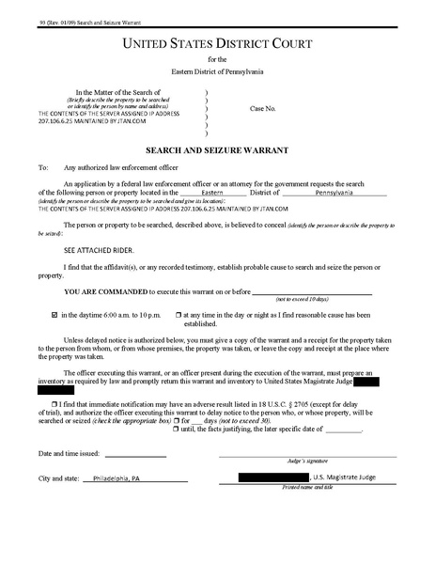
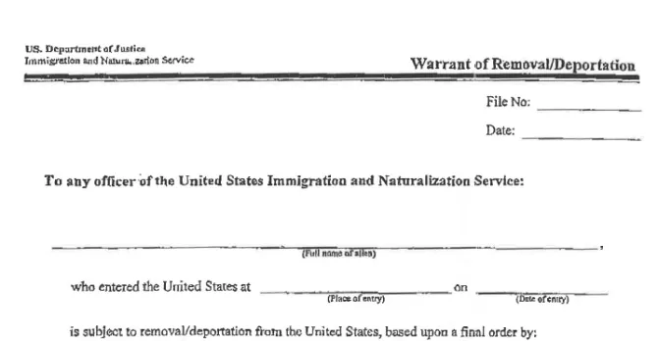
County or Federal Court
ICE “WARRANT”
Signature of Judge
JUDICIAL WARRANT

Slide 38
What If ICE Approaches You in the Community?
Remain calm – running away can give cause for ICE to arrest/detain you
Remain silent and do not answer any questions – especially about where you were born
Ask if you are free to leave
  “voluntary” inspection versus arrest/seizure
  If yes, calmly and silently walk away
Do not sign any documents until you speak with a lawyer
You do not have to consent to search of yourself or your belongings

Slide 39
What To Do If Detained by ICE?
DO NOT sign documents without legal help
  Could waive important rights
After providing your name and asking to speak to an attorney, exercise your right to remain silent
  Name is for locating you – if you give false name, difficult for family and attorney to find you
Contact attorney/legal services organization as soon as possible
Some people may be eligible to ask for release on bond

Slide 40
Will ICE be able to deport me right away if I am detained?
Usually no. If you have never had any contact with immigration before, you will have a right to a hearing before an immigration judge before you can be deported.
If you ask for a hearing, you might be detained during your removal proceedings.
If you do not wish to fight deportation, you can decline your right to a hearing and sign for voluntary return.

Slide 41
Getting Help
Where to get legal help
What to do if you are detained in the Northwest Detention Center

Slide 42
Legal Assistance
Getting good legal advice
Bad attorneys/consultants/notarios:
  Important to get things in writing
  If it sounds too good to be true…
  Experience in immigration law
  Unauthorized practice of law: Big Problem
Private Attorneys:
  Good advice is expensive
  Cases often take a long time
  Law is bad: attorneys are not magicians
  Important to be realistic about chances
Check if authorized to practice:
  Bar license and in good standing
  BIA-recognized agencies
    accredited representatives: authorized to practice immigration law

Slide 43
Legal Resources
Nonprofit Agencies:
  National Immigration Legal Services Directory:
    www.immigrationadvocates.org/nonprofit/legaldirectory/
  Executive Office for Immigration Review Roster of BIA-Recognized Agencies:
    www.justice.gov/eoir/find-legal-representation
Private Immigration Attorneys:
  American Immigration Lawyers Association (AILA) Referral Service:
    www.ailalawyer.com
Non-Immigration Legal Questions:
  CLEAR Hotline: *211
  www.washingtonlawhelp.org

Slide 44
NWIRP Intake Process
Western Washington:
  Call 206-587-4009 or 800-445-5771
Eastern Washington:
  Wenatchee: 509-570-0054 or 866-271-2084
  Granger: 509-854-2100 or 888-756-3641
If possible, specify issue: asylum, citizenship, domestic violence, removal, detention, family visa
Must leave a message with name and phone number
We cannot take every case
NWRIP protects confidentiality

Slide 45
If Someone is Detained by ICE
Hire private attorney to ensure representation in court
If not possible and individual is in NW Detention Center, call NWIRP’s Tacoma office:
  253-383-0519 and leave message with full name and A# (if known) of detainee
  Note: Tacoma office can provide legal orientation to detainee, but can only provide representation in a very limited number of cases

Slide 46
Northwest Detention Center
Operated by The Geo Group (private contractor)
Location
  Port of Tacoma
Size
  Currently, there are 1,575 beds
Government agencies on site
  EOIR (Tacoma Immigration Court)
  ICE (incl. Deportation Officers and ICE Trial Attorneys)
Notes:
Feel free to talk about the detention facility, etc…

Slide 47
How Do People End Up in Removal?
Interaction with criminal justice system
  ICE detains an individual after he/she was in jail or contact with probation officer
Filing an application (such as asylum) that is denied
  USCIS refers the case to ICE
Other interactions with ICE and Border Patrol
  Stopped at the border, checkpoints, raids, etc.
  Travel

Slide 48
Removal (Deportation) Proceedings
Process to determine if an individual should be deported from the United States;
Two questions:
  Is the individual deportable?
  If so, does he or she have a defense to deportation?
    Asylum, cancellation, etc…
Who is deportable?
  Individuals with no status or expired status;
  Green card holders (LPRs), primarily b/c of criminal conviction
Notes:
You can mention that sometimes US citizens get caught up in removal proceedings

Slide 49
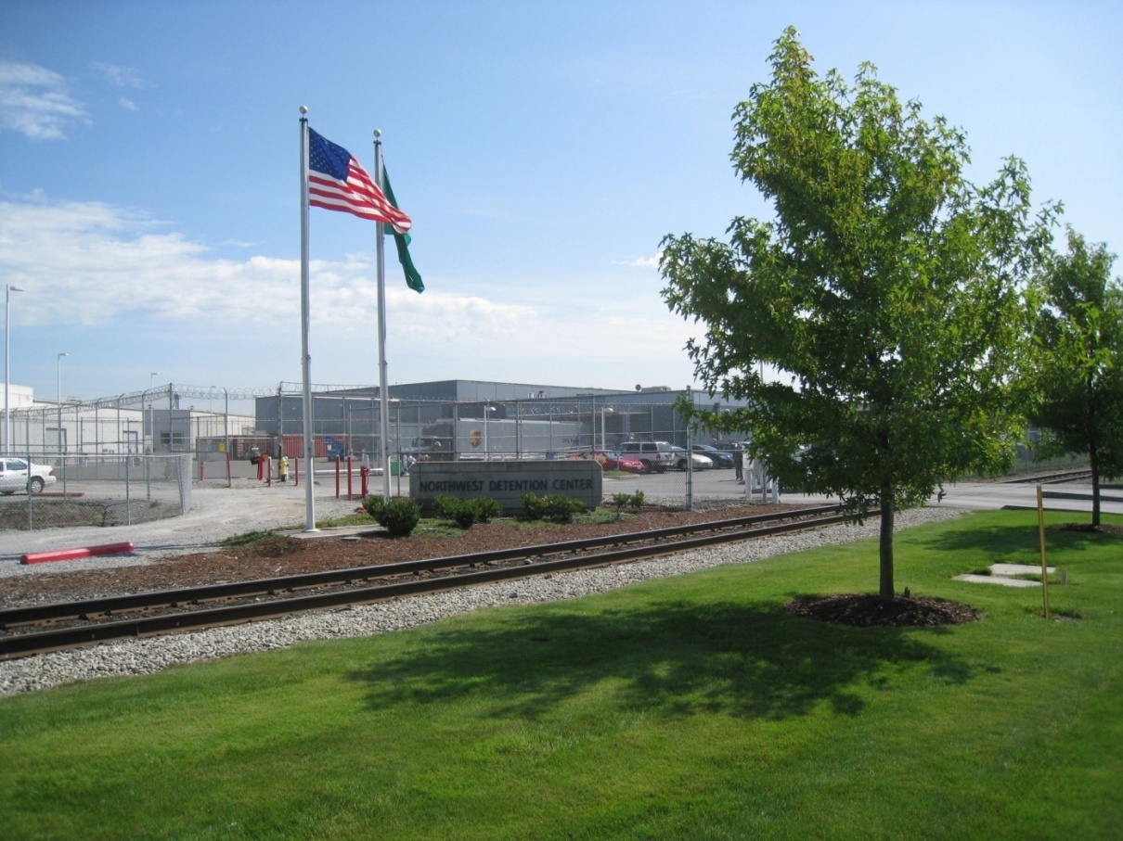
Immigration Detention: Possible Outcomes
Removal (Deportation)
Voluntary Departure
Release on Bond
Parole
Relief from deportation:
  Asylum/Withholding/CAT
  Cancellation of Removal
  Adjustment of Status
  U/T visas
Northwest Detention Center in Tacoma, WA

Slide 50
Immigration Court
Two courts in our region:
  Seattle: For non-detained cases;
  Tacoma: Detained cases at NW Detention Center
Important: There is NO right to an appointed attorney in immigration court if the person cannot afford private attorney.
Many people are forced to represent themselves:
  Approximately 35 % of removal cases in Seattle and 92% of those completed in Tacoma were unrepresented!!!

Slide 51
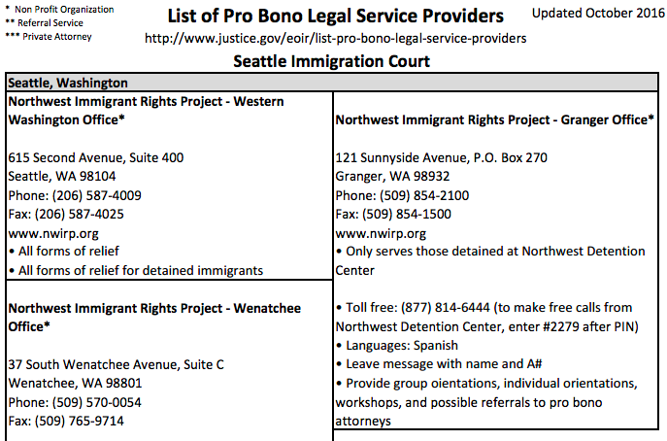
List of Free Legal Services Providers that is given in the Detention Center
Notes:
Here you can explain that detainees will go up to the immigration judge and ask if they can have an appointed attorney; they’ve heard on TV when the cops says “If you don’t can’t afford an attorney, one will be provided to you by the court.” But that’s of course not the case in immigration court. But they are given this piece of paper and it just has our name on it…

Slide 52
If you see someone being detained by Immigration Officials
TO REPORT IMMIGRATION ACTIVITY ANYWHERE IN WASHINGTON:
DIAL 1-844-RAID-REP (1-844-724-3737)
7 days a week | 6am – 9pm
The hotline allows people to report when loved ones or friends have been detained by immigration agents or other instances of problematic behavior conduct by immigration officials. When someone calls the hotline, volunteers will ask questions about the incidents to collect as much details as possible (including what did the agents uniforms look like? What markings were on the vehicles?) Callers will also be provided with information regarding resources available for those individuals detained by ICE or Border Patrol agents.

Slide 53
Cease and Desist - NWIRP
NWIRP has historically provided limited assistance to help those individuals fill out applications such as asylum; file motions to reopen removal proceedings, change venue, and to terminate proceedings; and advise them on defenses, and the procedural requirements for moving forward on cases. Last year alone NWIRP screened over a thousand people with cases pending before the immigration tribunals, and more than six hundred persons seeking to apply for asylum.
On April 5, 2017, the Department of Justice ordered NWIRP to cease and desist from assisting unrepresented immigrants facing deportation.
On May 8, 2017, NWIRP and the cooperating law firm of Davis Wright Tremaine LLP filed a lawsuit challenging the DOJ order, asserting that it violates NWIRP attorneys’ constitutional right to free speech, impeding their ability to promote and defend the rights of immigrants in Washington State.
On May 17, 2017, United States District Court Judge Richard A. Jones temporarily blocked the Department of Justice from preventing the Northwest Immigrant Rights Project from providing legal assistance to unrepresented immigrants facing deportation. The temporary restraining order will remain in effect until the court rules on a motion for a preliminary injunction.
Notes:
Here you can explain that detainees will go up to the immigration judge and ask if they can have an appointed attorney; they’ve heard on TV when the cops says “If you don’t can’t afford an attorney, one will be provided to you by the court.” But that’s of course not the case in immigration court. But they are given this piece of paper and it just has our name on it…

Slide 54


www.nwirp.org
Latest Immigration Updates Community Information Know Your Rights

Slide 55
Questions?
www.nwirp.org
Thank you!!

Slide 56

Fighting Back Fear
What We Can Do to Ensure Access to Food Assistance for our Newest Neighbors

Slide 57
Impact
Stories of immigrants withdrawing from federal nutrition assistance programs and food banks
Service with dignity and respect
Reports of agriculture labor shortages in California and Florida: millions in dollars lost due to unharvested crops

Slide 58
What Can We Do?
Welcome and engage
Fear containment
Take action

Slide 59
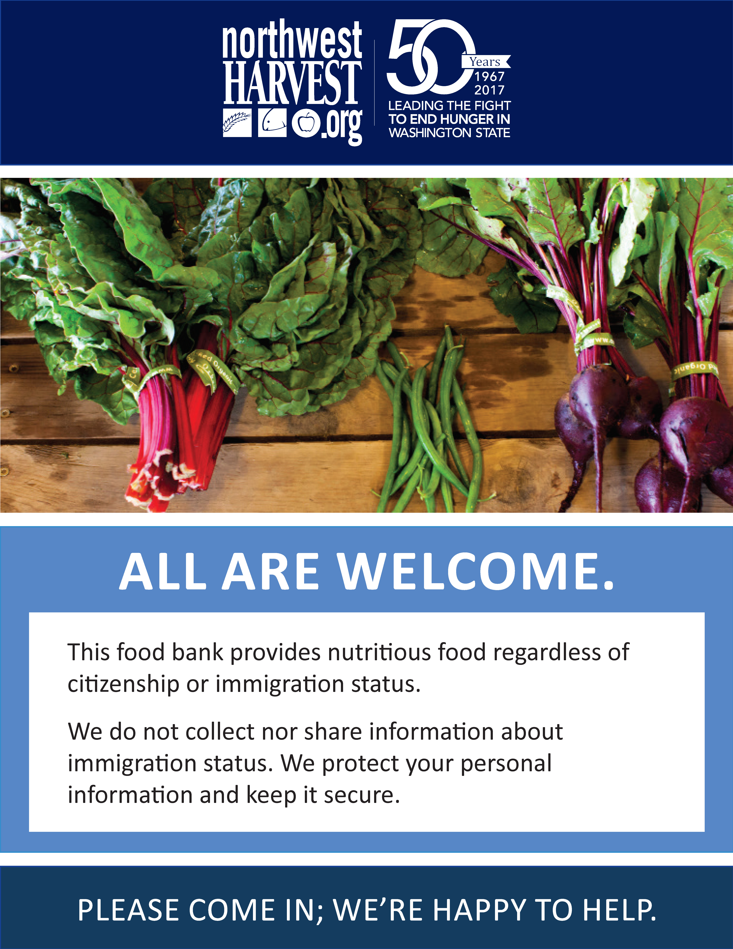
Welcome signage

Slide 60
Outreach to Immigrant Communities
Translated flyers
Social media
Radio, newspaper, and television PSAs
Trusted leaders in those communities

Slide 61
Safeguard Personal Information
Don’t need it? Don’t collect it.
TEFAP and EFAP: Identification card is not a requirement
  Consider taking any name and address given
Do not share information unless required to do so by law
Comply with the terms of a subpoena issued by a judge

Slide 62
Prepare your food bank
Safe sites memo
Elements
  Clearly defined roles
  Move your line out of public areas
  Comply with judicial warrants
  Document activity
Train your staff and volunteers
Sign up for alerts

Slide 63
Public education
Remind the general public that despite increased fear, there have been no changes to immigrant eligibility and right to access food assistance
Information about safeguarding personal information for school meals

Slide 64
Speak up!

Slide 65
Tools and resources
NWIRP Nonprofit Advisory: http://nwirp.org/nonprofit-org-advisory.pdf
Northwest Harvest Immigration Toolkit: http://www.northwestharvest.org/stuff/contentmgr/files/0/0b9ee4b8993bfd5987cd8684d9129993/files/immigration_rights___resources_toolkit_final.pdf
Statewide Workgroup: contact Christina or Nikki for more information

Slide 66
Questions?
Christina: christinaw@northwestharvest.org
Nikki: nikkih@northwestharvest.org

